Slide 1
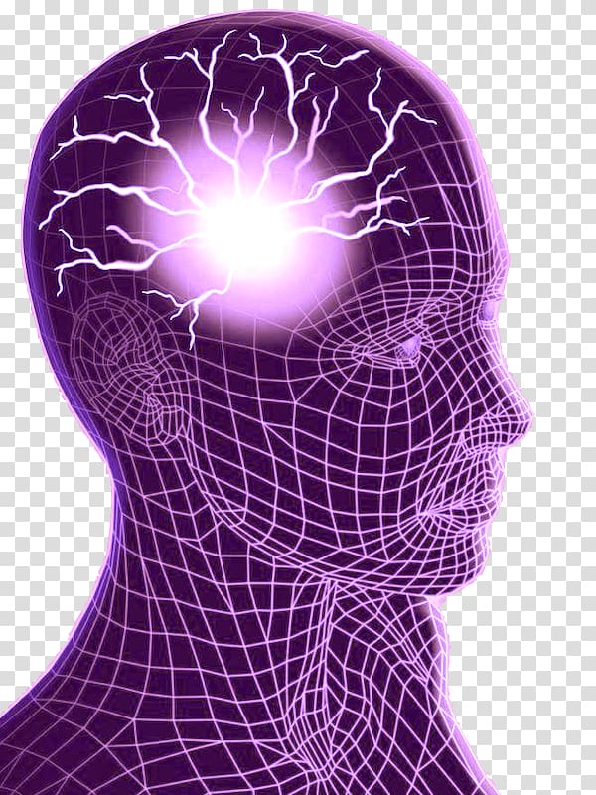
Seizure Training

Slide 2
Health Observation Guidelines
Seizures
Many individuals have known seizure disorders. The symptoms may vary. A seizure disorder can occur at any time in life. It is very important to receive immediate medical treatment for the first seizure that a person may have. It may be of unknown cause or may result from a brain injury such as from a fall with a blow to the head. A new seizure disorder must be carefully looked at to rule out brain tumor.
It is important to know what is normal for a person. A change from normal needs to be reported to a healthcare provider.
Topic/ function

Slide 3
Please click this link to watch this short YouTube video titled: #ShareMySeizure: Michael’s Basketball Team Learns Seizure First Aid. Make sure that you are in presentation mode to view link. (Slide Show tab > From Current Slide)
https://www.epilepsy.com/learn/seizure-first-aid-and-safety

Slide 4
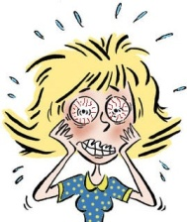
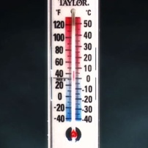
Triggers
Even with therapeutic blood levels of anticonvulsant medications, certain events can alter a person’s seizure threshold:
Stress, emotional upset
Physical Illness or infections
Temperature change
Photosensitivity

Slide 5
Seizures
Recognizing Focal aware tonic seizures (generalized grand mal) seizures are the most easy to recognize.
Some signs are:
Loss of consciousness
Loss of bladder or bowel control
Eyes may roll back into head
No control of movement, speech or actions
Person may initially stop breathing or they may look pale, lips may turn blue
Convulsions
Following the seizure the person may be very tired and need to rest.
An “aura” is a partial seizure that may occur prior to a generalized seizure. An “aura” is experienced as a particular sensation that may precede a generalized seizure. People who experience am “aura” may sit down or not get up from a chair recognizing that they are about to have a seizure.

Slide 6
Seizures
Focal impaired awareness(complex partial) & Focal aware(simple partial)seizures may be difficult to recognize especially in non-verbal individuals. Some signs are:
Decrease in the level of consciousness but no loss of consciousness
Person unable to respond
Facial movements, eye or mouth movements
Drooling or purposeless behavior (lip smacking )
Shaking or jerking of a body part (i.e. arm/ hand or leg/ foot)
Sudden emotional response, may cry out or laugh.
Wandering, may run in fear
Nausea

Slide 7
What to Do During a Seizure
Care During a Convulsive Seizure:
Remain calm
Do not restrain the person
Protect body and head from sharp objects, remove eyeglasses
Loosen clothing around the neck
Turn person on their side to protect airway
Never place your hands or anything in the mouth of person having a seizure
Track the time of the seizure and be able to describe what it looked like
For a Non-convulsive Seizure:
Do not restrain
Stay calm and track time
Redirect person from hazards
Do not agitate, speak calmly
Always stay with individual having seizure
Individualized Seizure protocol- a protocol to follow written by doctor or neurologist for a specific person. It’s a guideline on when to call EMS and when to call the doctor.

Slide 8
SEIZURE PROTOCOL

Slide 9
What to Do/Not Do during a Convulsive seizure
STAY CALM
PROTECT head
(remove eyeglasses)
LOOSEN clothing
TURN person ON SIDE to protect airway
TRACK TIME
DO NOT PANIC
DO NOT RESTRAIN
NEVER PLACE ANYTHING IN MOUTH
DO NOT LEAVE THE PERSON
DO
DO NOT

Slide 10
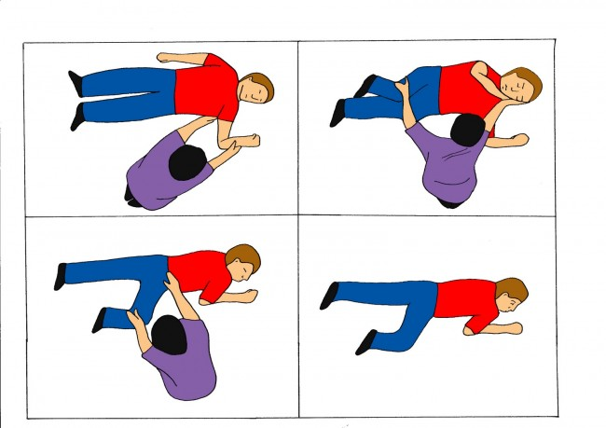
Recovery Position

Slide 11
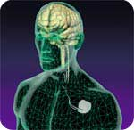
Treatment
Treatments for management include:
Medication
Vagal Nerve Stimulator
Surgical intervention

Slide 12
Medications: Anticonvulsants
Medications are used to minimize or block the spread of electrical stimuli.
Approximately 70-80% of people use one or more anticonvulsants to control seizures
Most anticonvulsants require time to reach therapeutic levels
Some seizure medications can “build up” in the body
and become toxic and sick. Being toxic can cause
more seizures.
Blood tests are done to see if medication is
therapeutic
People can be very sensitive to medication changes.
Missed doses or med changes can increase risk of seizure activity.

Slide 14
When to Call 911 for a Seizure
Status epilepticus (individual has one seizure after another ) Status epilepticus is a medical emergency)
The individual does not resume breathing after the seizure. Give CPR.
Significant bodily injury
A first time seizure or a change in an individual’s seizure pattern
Any seizure lasting more than 5 minutes unless otherwise indicated by the health care provider.

Slide 15
Seizure Aftercare
Reassure individual. They may be very tired and require rest.
Stay with the individual until they are fully awake and oriented.
Do not offer food or drink until the individual is fully conscious.
Follow the individualized seizure protocol for additional care & notification.
If individual is having an increased number of seizures call the HCP.
Document seizure and complete Seizure Observation Report
Seizure Observation Report- a form that you fill out when an individual has a seizure. It gives a report of what you directly observed happening before, during and after the seizure

Slide 16
Seizure Documentation
What to document:
Time it started
How long it lasted
What the seizure looked like
What happened after seizure
Seizure Observation Report

Slide 17
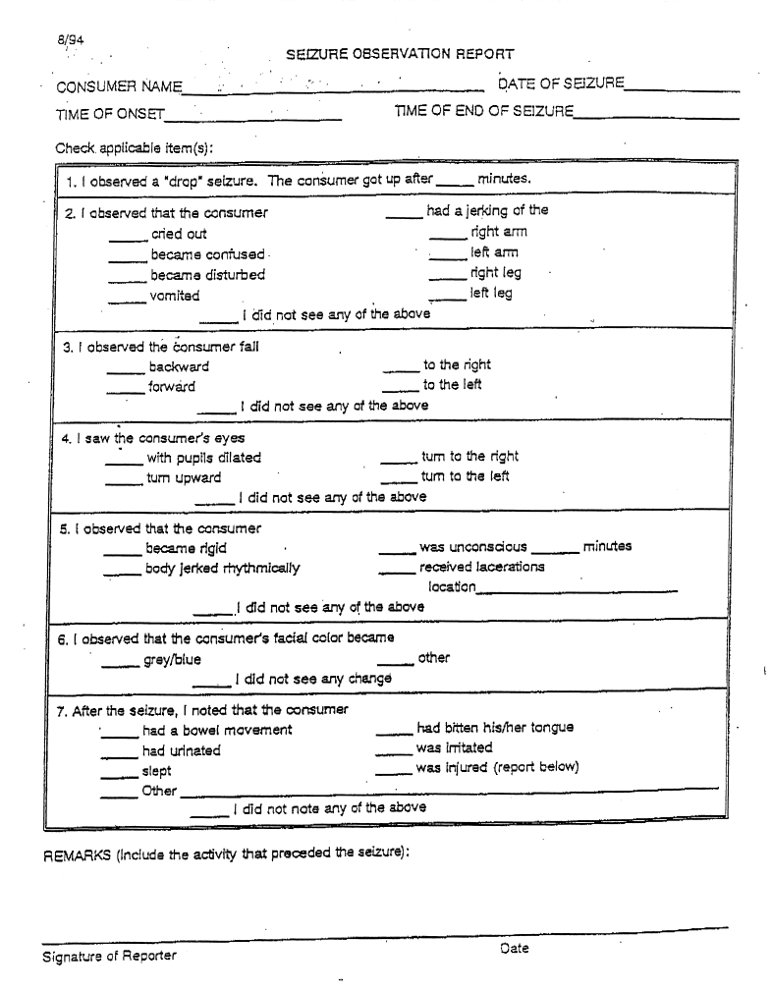
SEIZURE OBSERVATION REPORT

